Slide 1
DeepTour
Deep Learning for Tourism

Slide 2
New Pitch !
Flyers are the most common way to get information on the landmark you’re visiting but you never know what to do with it afterwards
Wikipedia is weightless and more detailed but has less links to the actual landmark (Where is what ? What is what ?)
None of those are interactive
DeepTour provides an interactive solution with the best of both worlds

Slide 3

Our project
Using small context dependent CNNs, we provide an interactive experience for specific landmarks
The application is built to be scalable and lightweight:
A data pipeline built on Google Cloud platform makes it extremely easy to add new models to the library
The landmark specific approach allows smaller training sets and models
Even devices with low camera resolution can run the app
It respects your privacy:
The models size allows to run them offline without latency
The camera feed is not recorded

Slide 4
What’s new
Changed the context
Midterm remarks focused on the lack of context
What’s the added value of object detection in this environment ?
Changed the model
Prototype model (Yolo v3) compression did not work
Reduced similar models were still too heavy (10s latency, 80Mb)
One solution to both problems
Localized models, specialized on one landmark
Implemented models:
Gyeonbokgung
Yeouido

Slide 5
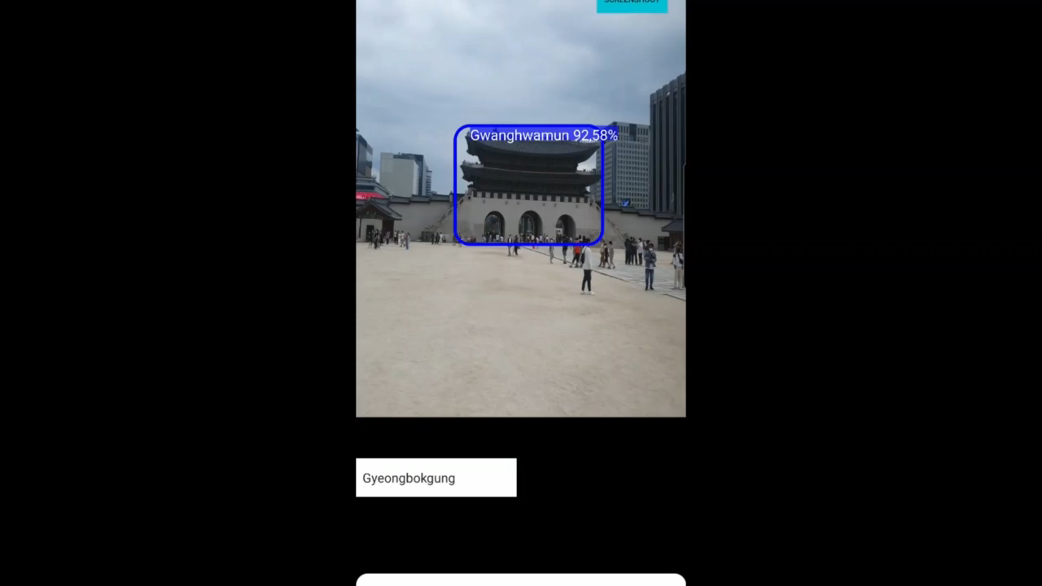
Use case and demo
Choose your model at the entrance of the landmark
Walk around the area, looking for detectable objects/buildings to learn about the area
Pause to read the quick description and click the link to learn even more

Slide 6
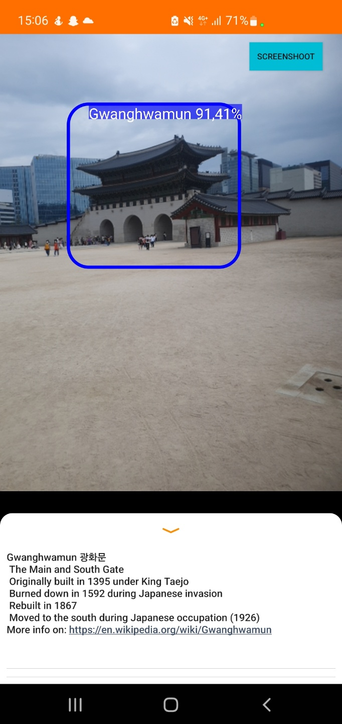
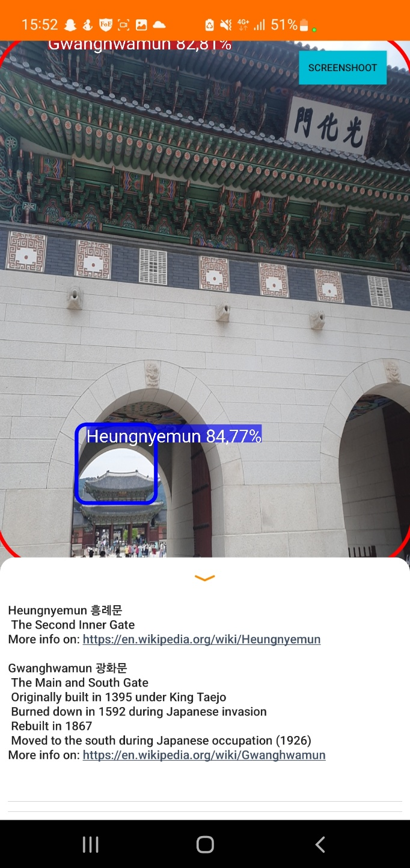
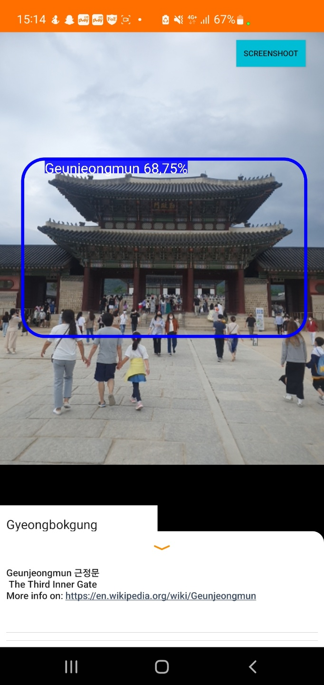

Slide 7
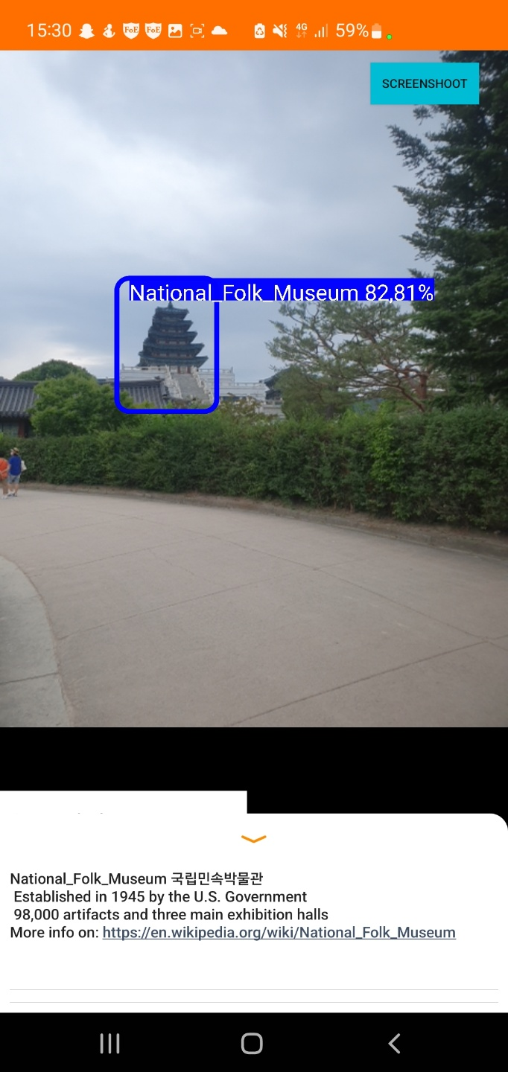
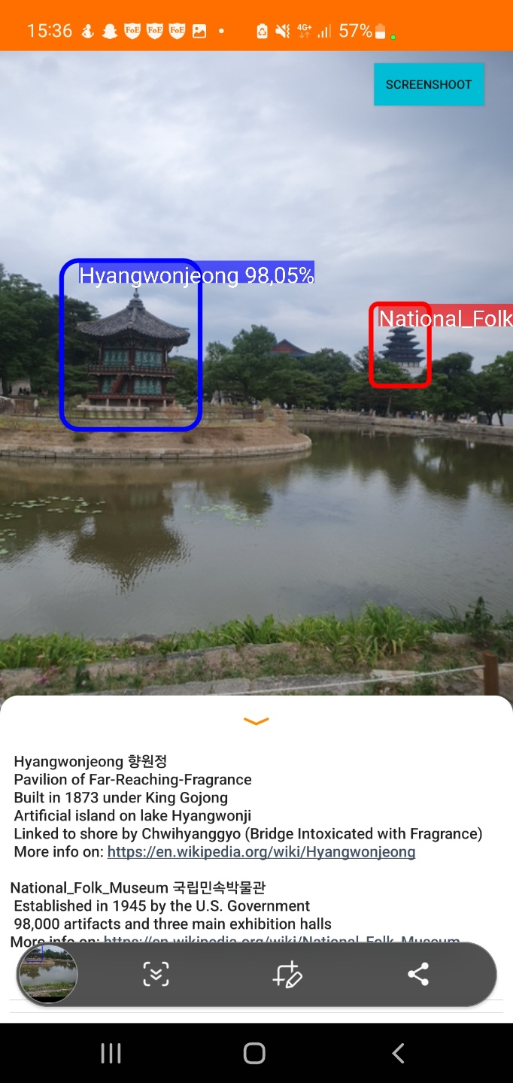
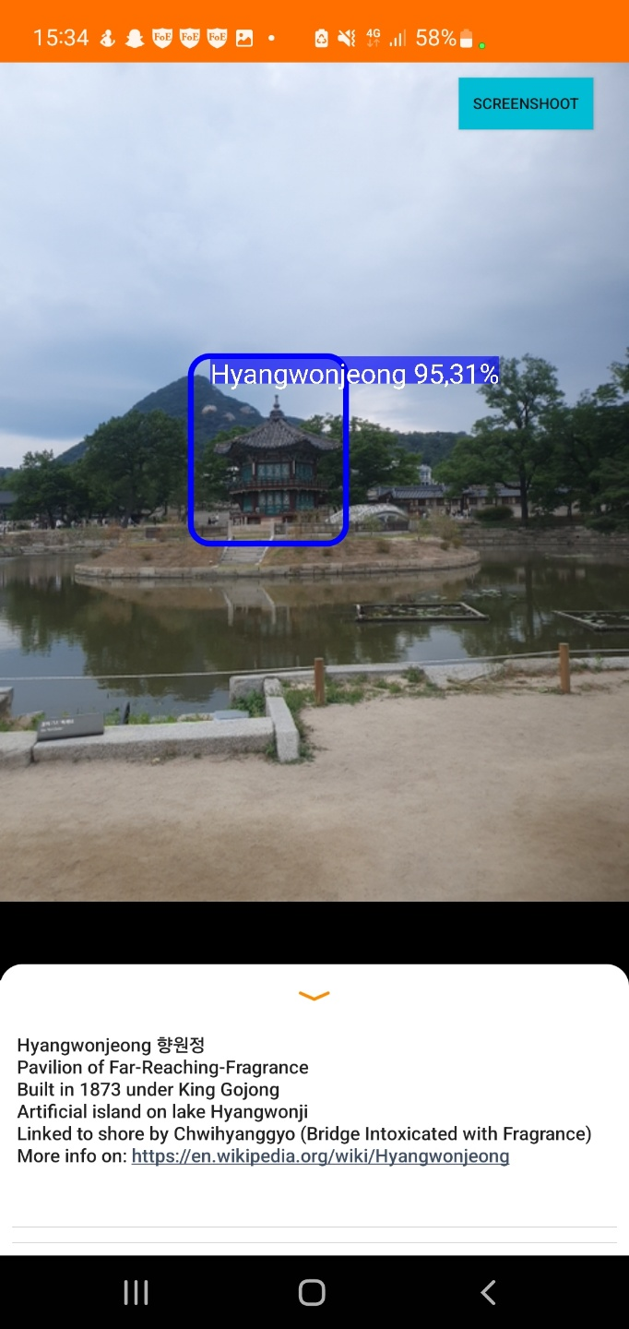

Slide 8
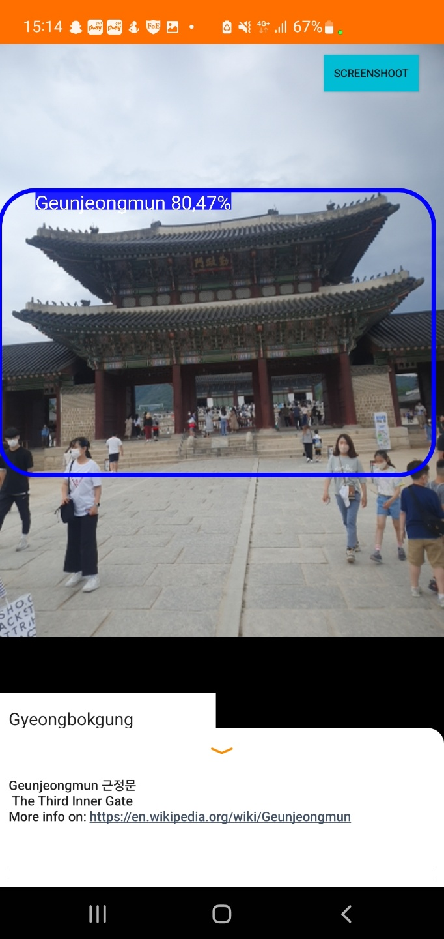
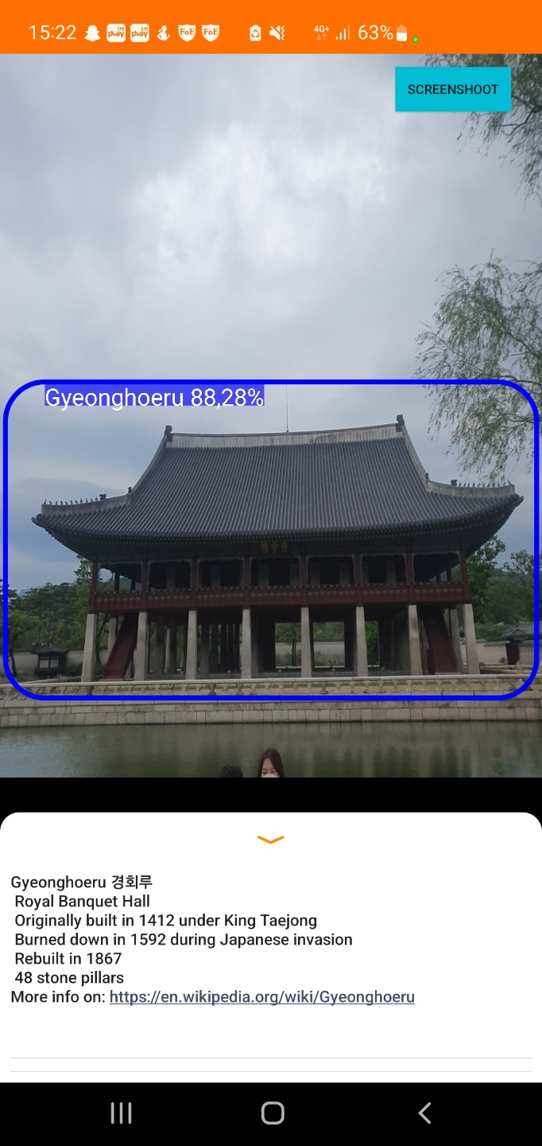

Slide 9
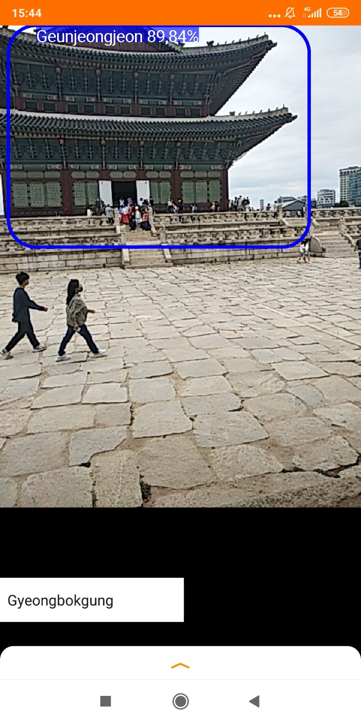
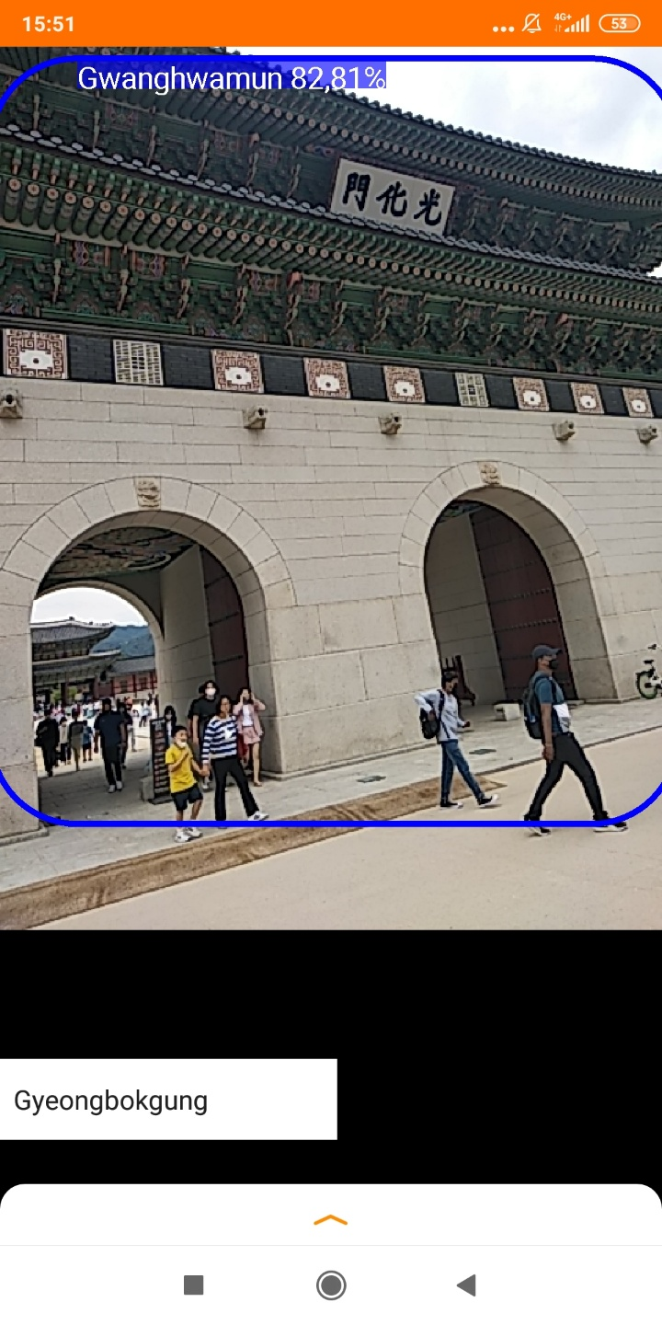

Slide 10
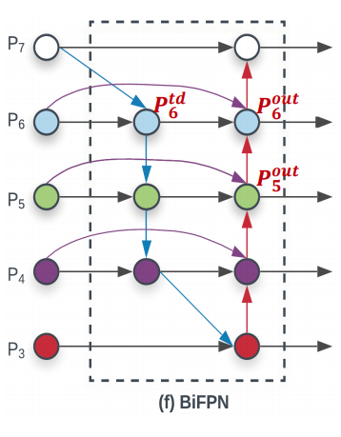
Technical review
YOLOv3 did not work on the phone due to large latency
YOLOv3 Tiny had the same issue
Solution – EfficientDet (based on EfficientNet)
Utilizes compound scaling - scaling each dimension by a constant ratio
Apply bidirectional feature pyramid network (BiFPN)
Learnable weights to determine the importance of different input features

Slide 11
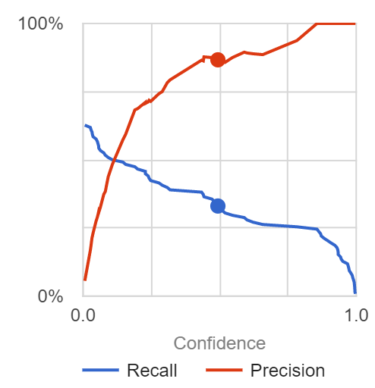
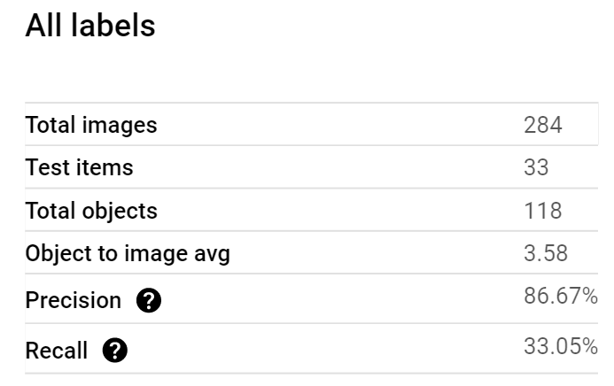
Gyeongbokgung

Slide 12
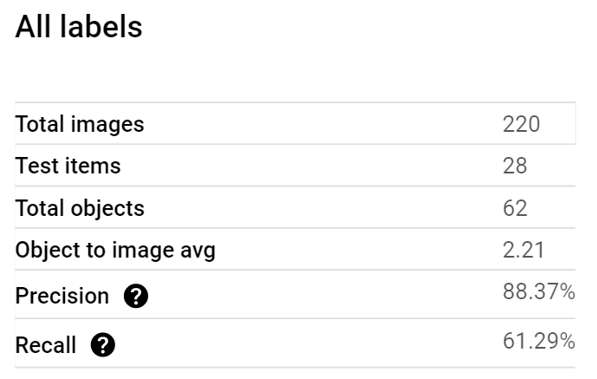
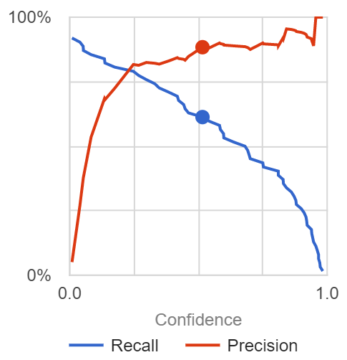
Yeouido

Slide 13
 | Tasks | 7 April | 14 April | 21 April | 28 April | 2 May | 9 May | 16 May | 23 May | 30 May | 6 June
 | Search a dataset to train | YL, ND |  |  |  |  |  |  |  |  |  | Done
 | Process dataset |  |  | YL, AP |  | Delayed |  |  |  |  |  | Done
Deep Learning (Python) | Build/Adapt a Neural Network model |  |  | AP, ND |  |  |  |  |  |  |  | Done
 | Train the model |  |  |  | AP |  |  |  |  |  |  | Done
 | Adapt the model for smartphone |  |  |  |  | AP, ND |  | Delayed |  |  |  | Done
App dev (Android, Java) | Setup retrieval of video flux |  |  | YL, AP |  |  |  |  |  |  |  | Done
 | First UI design |  |  |  | YL, ND |  |  |  |  |  |  | Done
 | Retrieve coordinate of the monument in the screen |  |  |  | YL, ND |  |  |  |  |  |  | Done
 | Setup basic content generation (Layout on Android) |  |  |  | YL, ND |  |  |  |  |  |  | Done
 | Intermediate presentation |  |  |  | Preparation |  |  |  |  |  |  | Done
 | Feedback modifications from Intermediate report |  |  |  |  |  | YL, ND, AP |  |  |  |  | Done
 | Final UI design |  |  |  |  |  | YL, ND |  |  |  |  | Done
 | Expand model |  |  |  |  |  | YL, ND, AP |  |  |  |  | Done
 | Evaluation/Test in real condition |  |  |  |  |  |  | YL, AP |  |  |  | Done
Optional | Participative training set |  |  |  |  |  |  |  | ND, AP |  |  | Cancelled
 | 360 Camera feed |  |  |  |  |  |  |  | AP, YL |  |  | Cancelled
 | Screen guidance / recommandation |  |  |  |  |  |  |  | YL, ND |  |  | Cancelled
 | Separate models (add-ons) for different Landmarks |  |  |  |  |  |  |  |  | YL, ND, AP |  | NEW (Done)
 | User study |  |  |  |  |  |  | ND, AP |  |  |  | Done
 | Final presentation |  |  |  |  |  |  |  |  | Preparation |  | Done

Slide 14
Notes and Discussion
Roles and contributions
Data: Norman
ML: Andrei
Android: Yohan
Data and ML are upstream processes of the app development
Git used to store some data initially but the application itself has been mainly pushed by Yohan
Application tested on 3 android phones
Different computational power and camera resolution (Galaxy S10+, Samsung A50, Redmi 5+)
Different android OS (8.1 to 12)
Compatibility issues arose but the app is functional overall

Slide 15
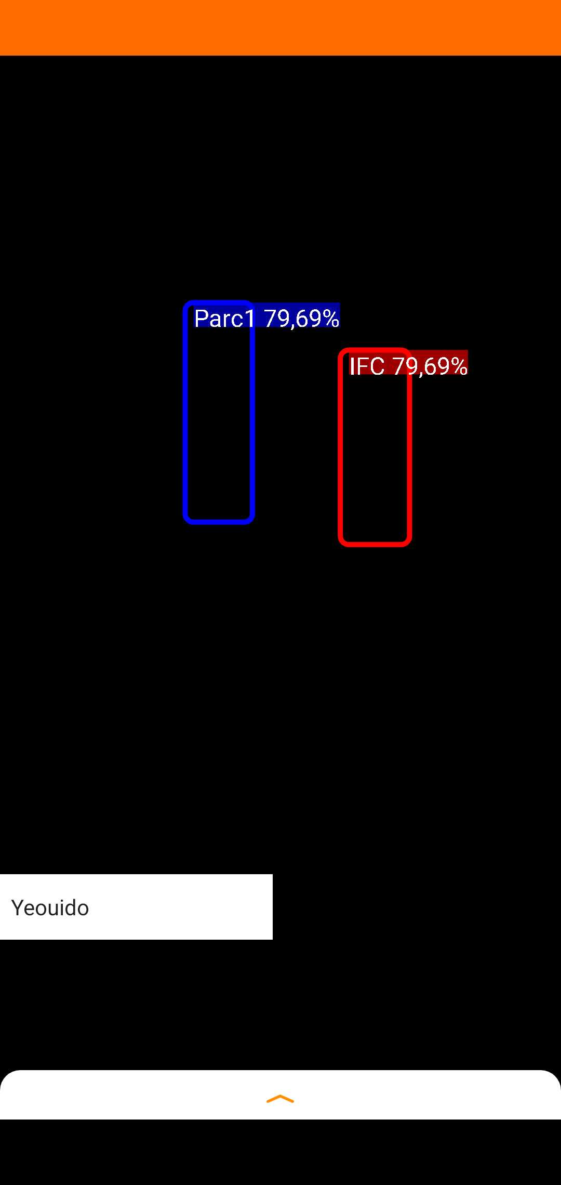
Annexe
Compatibility issues
Screenshot authorizations

Slide 16
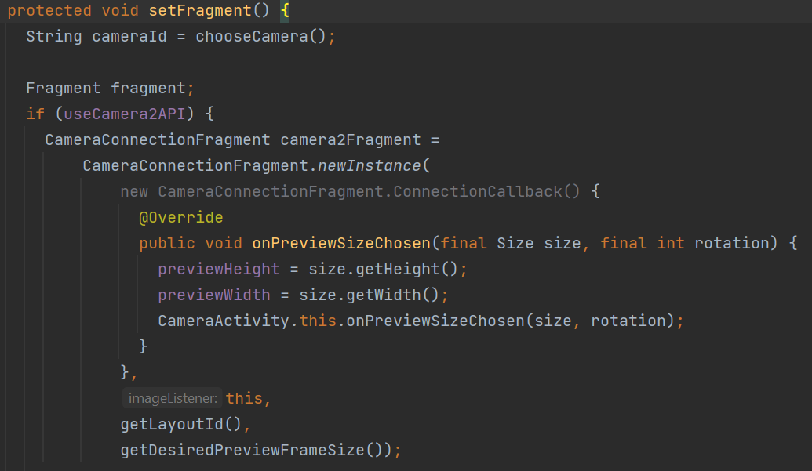

Slide 17
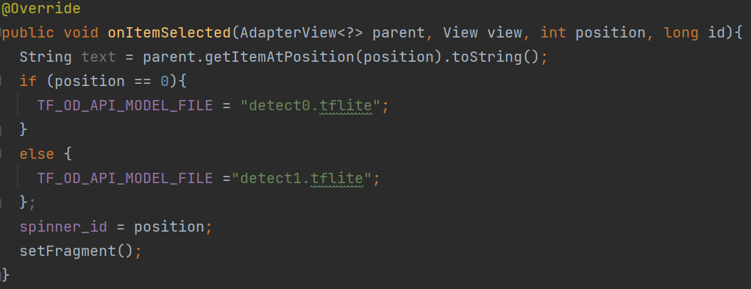

Slide 18
